Slide 1

BANK LOAN OF CUSTOMERS
DOMAIN:- FINANCE

Slide 2
Presented by:
Ms. Ravina Khade
Ms. Shyamli Vitthal Patil
Ms. Radhika Vikram Rajale
Ms. Paduchuri Akanksha
Ms. Ruchita Rajabhau Deshmukh
Ms. Dhanashri Raghunath Salunkhe
Mrs. Tejal Vivek Acharekar

Slide 3
INDEX
INTRODUCTION
OBJECTIVE
DATA PROCESS
OUTPUT
CHALLENGES
RECOMMENDATION
CONCLUTION

Slide 4
INTRODUCTION
In the finance domain, understanding customer behavior and managing loans efficiently is important for banks and other financial institutions. This project focuses on analyzing two datasets, Finance_1 and Finance_2., which contain important records related to bank loans and various key performance indicators (KPIs). These datasets provide valuable insights into customer loan behavior, loan amounts, payment statuses, home ownership trends, and more.

Slide 5
OBJECTIVE
Objective of this project is to study the datasets to gain insights within the bank. Specifically, the project aims to achieve the following objectives. such as Loan Amount Analysis by Year, Grade and Subgrade-wise Revolving Balance , Payment Status Analysis, State and Month-wise Loan Status, Home Ownership and Last Payment Date. By achieving these objectives, the project aims to provide valuable insights for contributing to the bank's overall efficiency and profitability.

Slide 6
DATA PROCESS
Data Collection and Cleaning
Gather The data from source and identify the data accuracy, integrity.
Data Integration
Merge data from multiple sources to create a unified dataset for analysis. This may involve matching records based on common identifiers.
Exploratory Data Analysis(EDA)
Visualize data using charts, graphs, and dashboards to explore patterns, correlations and outliers.

Slide 7
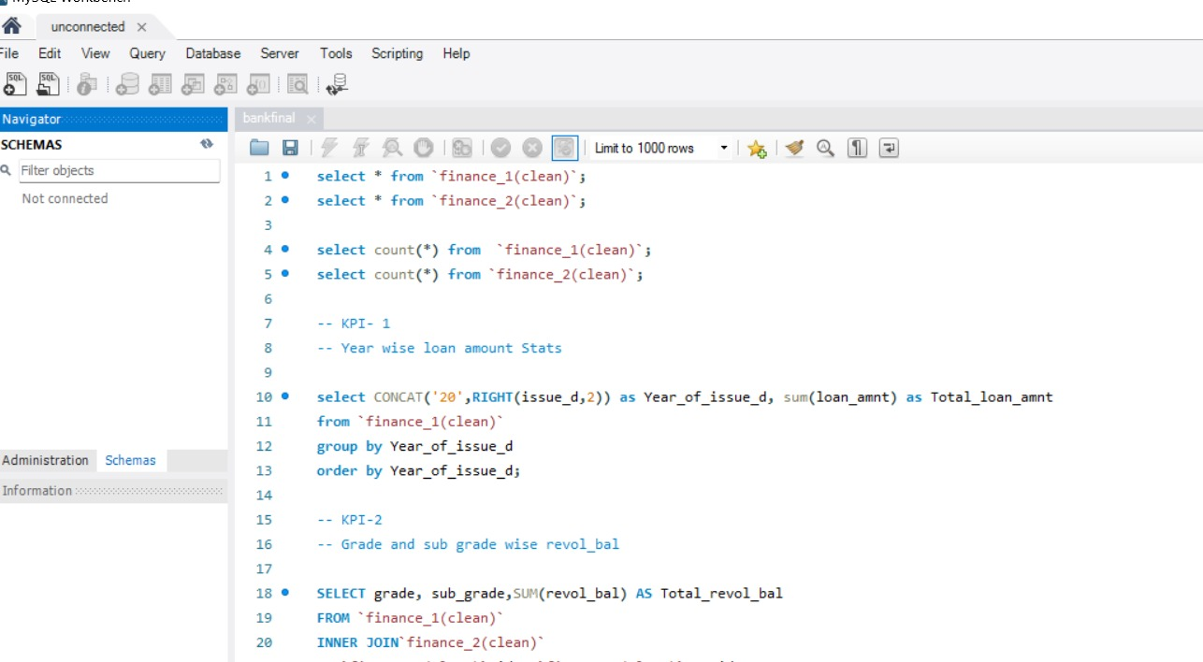
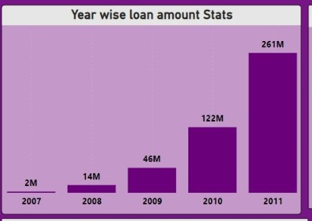
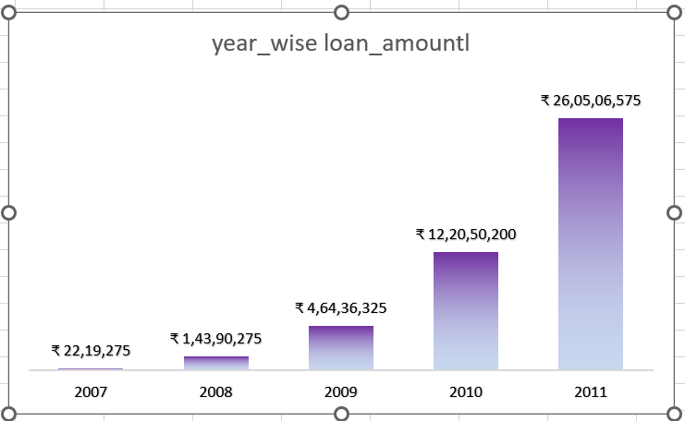
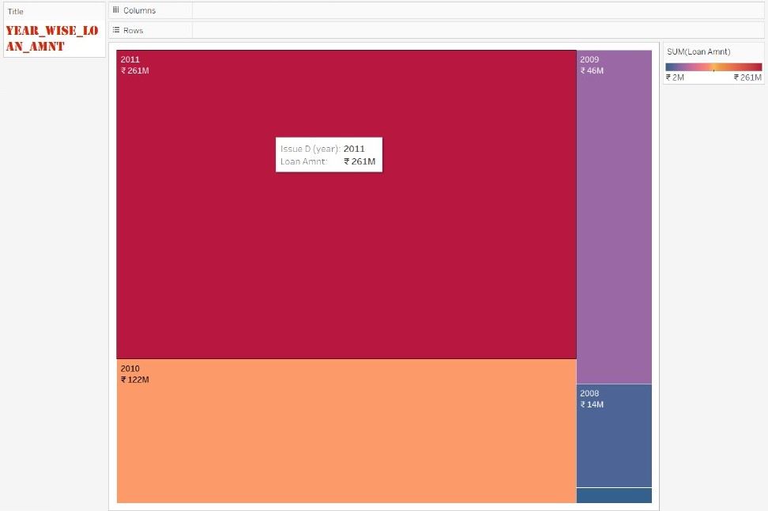
OUTPUT
KPI 1:- Year wise loan amount statistics
This KPI represents sum of loan amount from year 2007 to 2011, which clearly shows us that the loan amount is increasing from 2007 to 2011, where 2007 has minimum loan amount i.e 2M and 2011 has maximum loan amount i.e 261M.

Slide 8
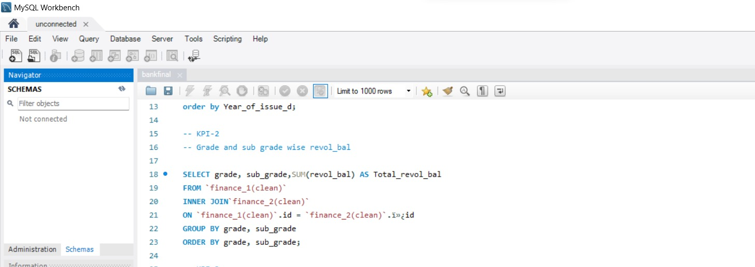
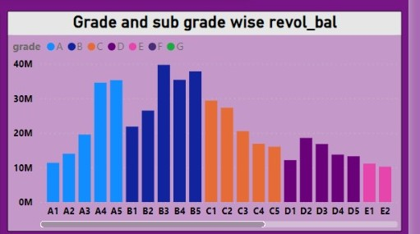
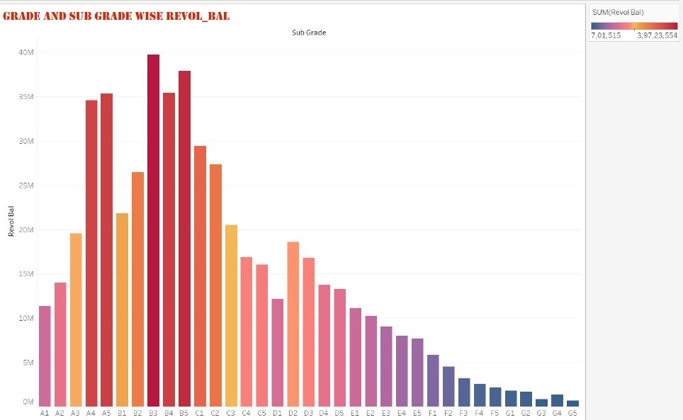
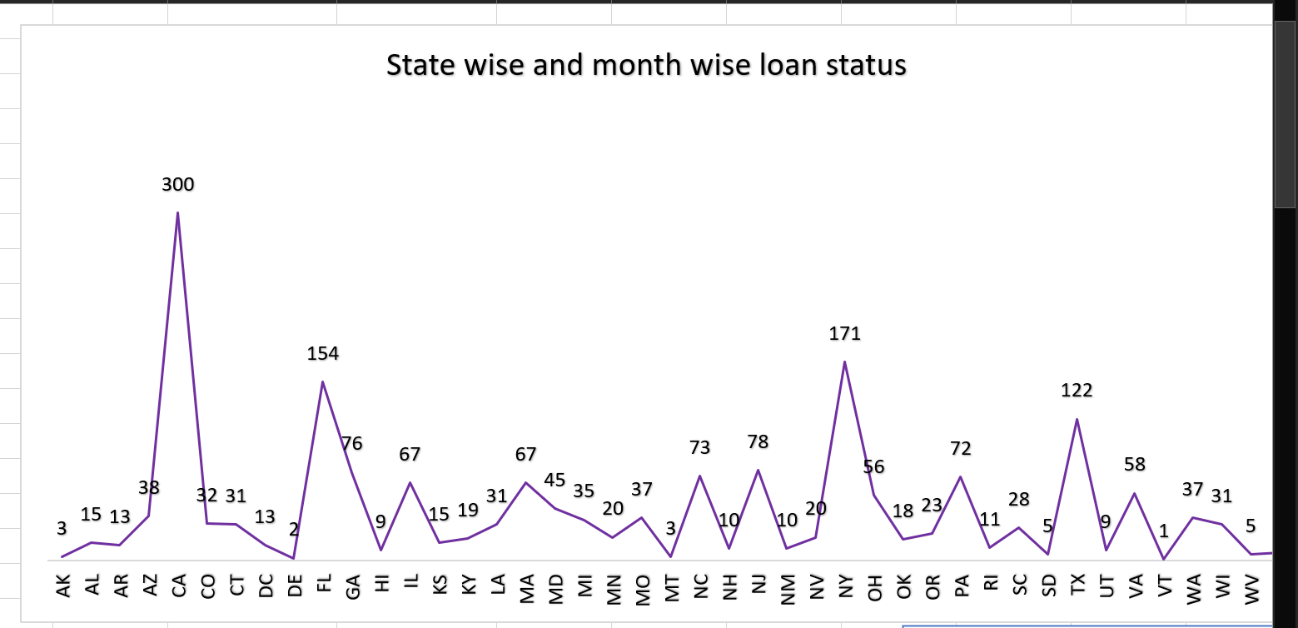
KPI 2:- Grade and sub grade wise revol_bal
This KPI represent revolving balance according to grade and sub-grade , showing us B3 has most revolving balance around 30M and G5 has least i.e 3K revolving.

Slide 9
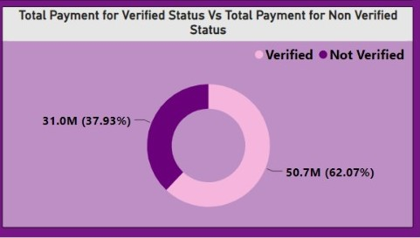
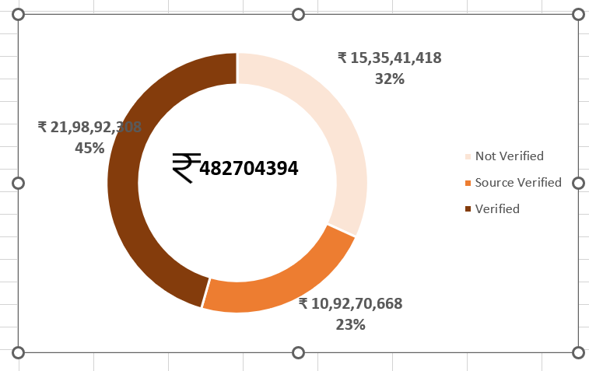
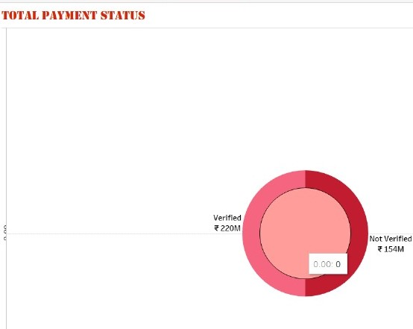
KPI 3:- Total payment for verified status Vs Total payment for non-verified status
As it appears to be a donut chart, showing us the total payment of verified and non- verified status, where they are nearly the same with the difference of nearly 70M.

Slide 10
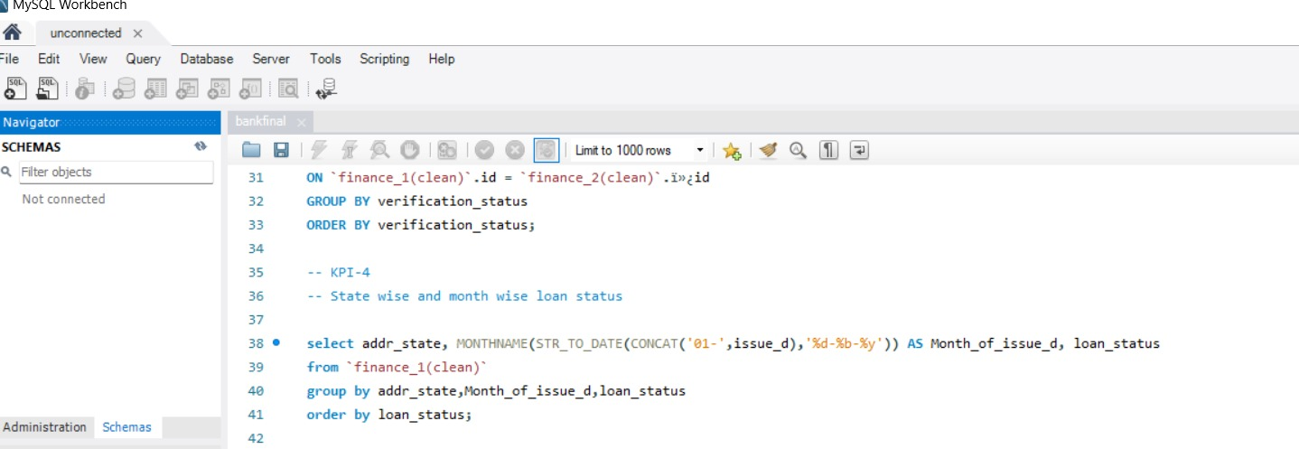
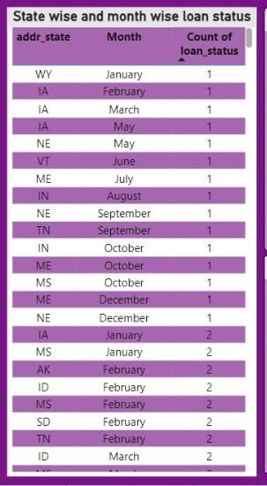
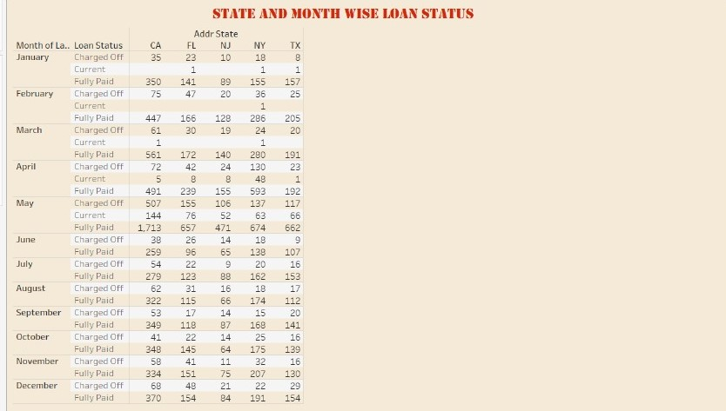
KPI 4:- State wise and month wise loan status
In this KPI, these text tables investigate the loan status across different states and months to detect any geographical or temporal variations that may impact loan performance and repayment.

Slide 11
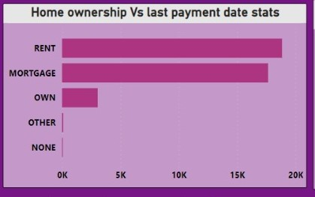
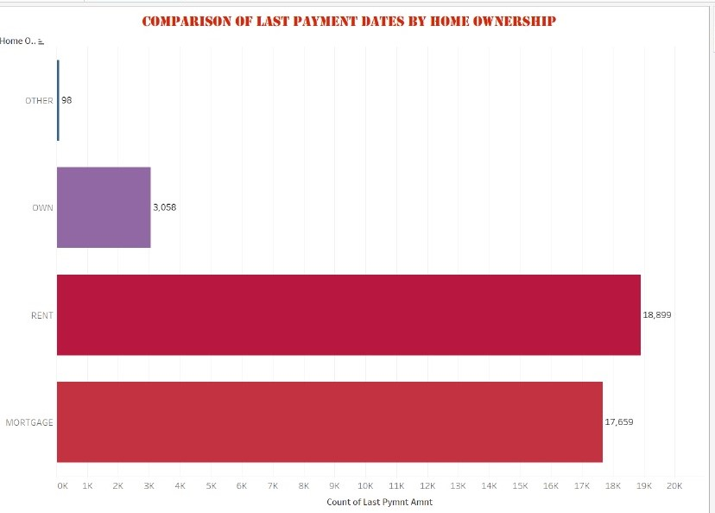
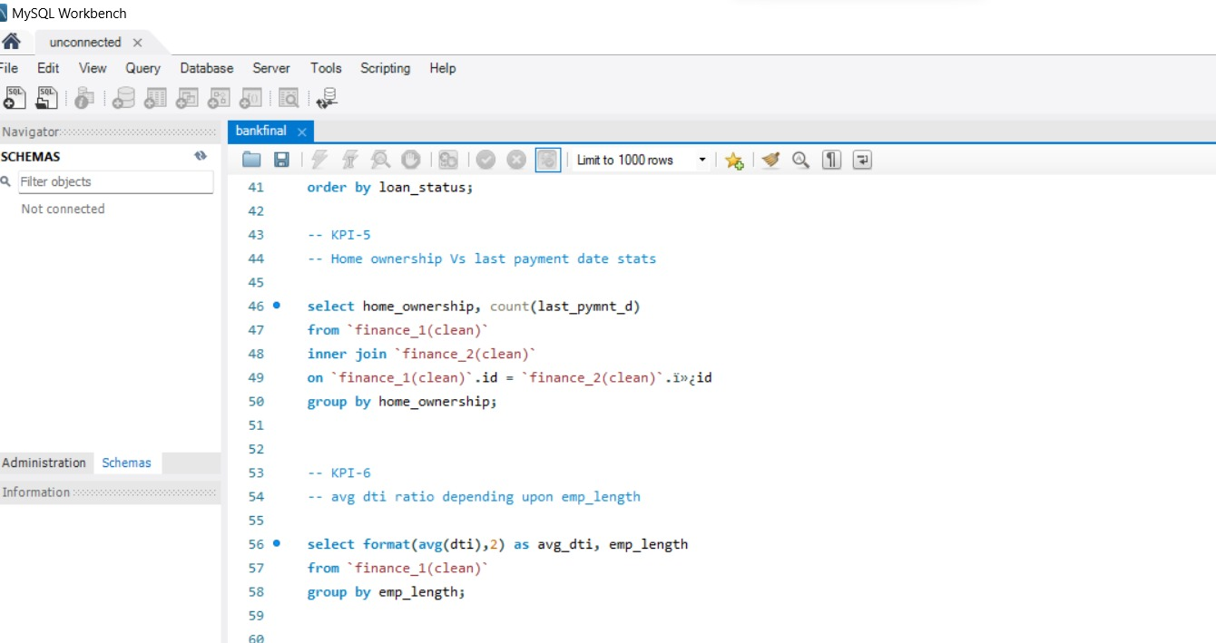
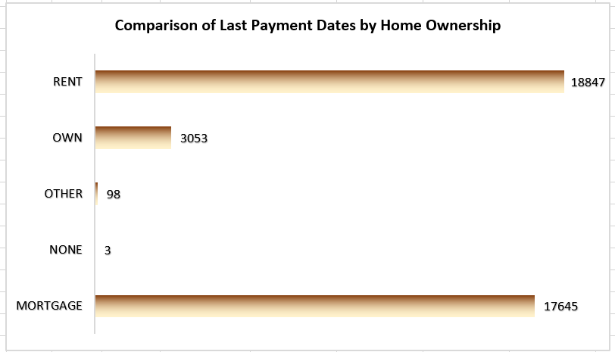
KPI 5:- Home ownership Vs last payment date statistics
This KPI shows comparison of last payment dates by home ownership where around 3K people own houses, till 19K people have rented homes and nearly 18K people have mortgage. Thus, showing us that maximum people i.e 19K have rented homes.

Slide 12
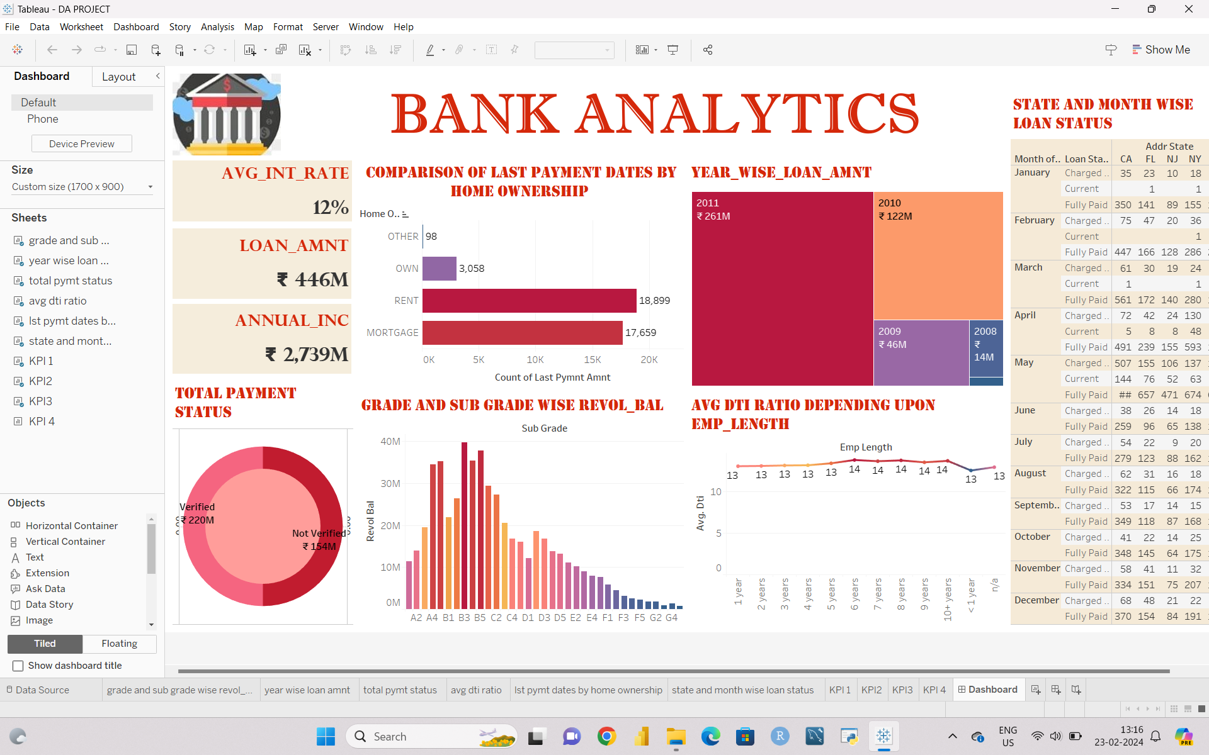
DASHBOARDS
Here are the 3 dashboards in different tools:
1] TABLEAU

Slide 13
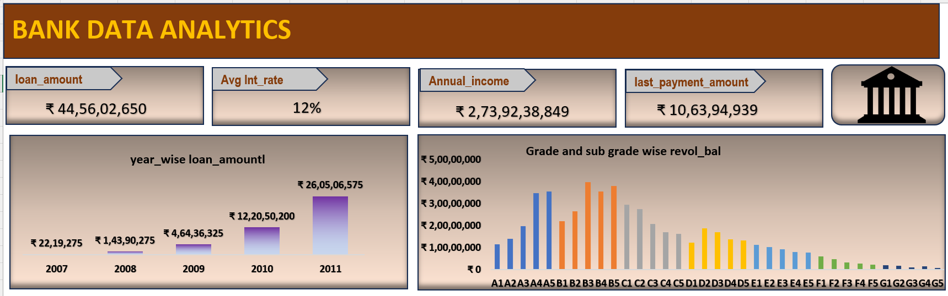
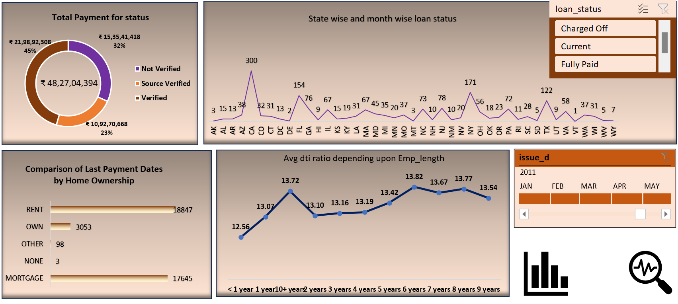
2] EXCEL

Slide 14
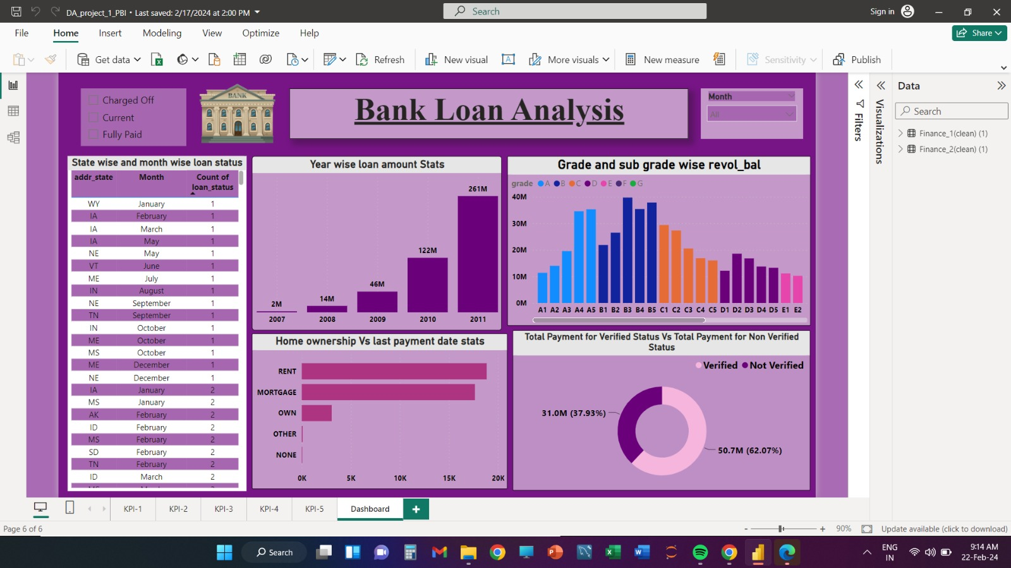
3] POWER BI

Slide 15
CHALLENGES
Data cleaning: Removing unwanted fields from the datasets.
Data Integration: Combining and reconciling data from multiple sources (Finance_1.xlsx and Finance_2.xlsx)
Complexity of Analysis: Analyzing large datasets with over 39k records each, with multiple KPIs such as year-wise loan amounts, grade-wise revolving balances, and state-wise loan statuses, has been complicated, computationally intensive and time-consuming in itself.

Slide 16
RECOMMENDATION
Based on the provided KPIs and their interpretations, here are some suggestions and recommendations:
Loan Amount Trends (KPI 1): Explore further to understand the underlying factors driving the increase in loan amounts from 2007 to 2011. Are there specific loan products or market conditions contributing to this trend?

Slide 17
Home Ownership vs. Last Payment Date (KPI 5): Explore the implications of the higher number of rented homes compared to owned or mortgaged homes on loan repayment behavior. Are renters more likely to default on loans compared to homeowners?
State-wise and Month-wise Loan Status (KPI 4): Utilize geographical and temporal variations in loan status to develop targeted strategies for loan management in specific regions .

Slide 18
CONCLUSION
In conclusion, while the analysis provided valuable insights, it's important to recognize limitations such as missing data, format and quality, These factors should be considered when interpreting results and making decisions. Addressing these limitations provide improved data which can enhance the effectiveness of loan management strategies in the finance domain.

Slide 19
THANK YOU

